Slide 1
VIRTUAL MACHINES
Varun Ram S
(DI SW PLM IES DMA MAS)

Slide 2
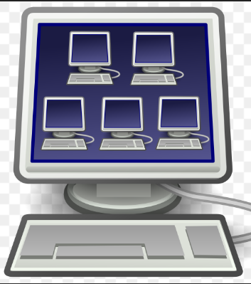
What Exactly is a VIRTUAL MACHINE?
Computer resource that functions like a physical computer and makes use of software resources only instead of using any physical computer for functioning, running programs, and deploying the apps
Experience of end user is intended to be kept same as that of using a physical device
Has own operating system, storage and memory and can connect to the internet just like a physical device.

Slide 3
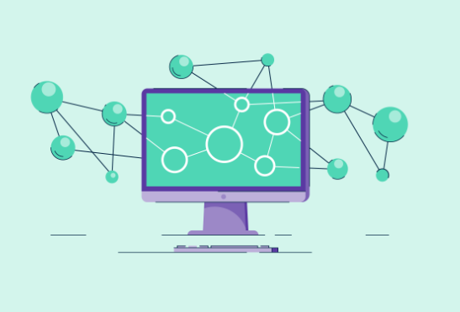
Why virtual machines?
Backup of any Physical Device
Software Testing
Program Development
Cybersecurity
Faster Recovery
Less Physical Components
Multiple Users/Operating Systems

Slide 4
TYPES OF VIRTUAL MACHINES
Process Virtual Machine:
Process virtual machine is allows only a single process to run as an application on the host system and provides a platform-independent environment.
Gets created once the process is started and gets destroyed when the process ends.
Example: JVM (JAVA Virtual Machine)
System Virtual Machine:
A system virtual machine is fully virtualized to substitute a physical machine.
The physical resources of the host device are shared among the multiple VMs.

Slide 5
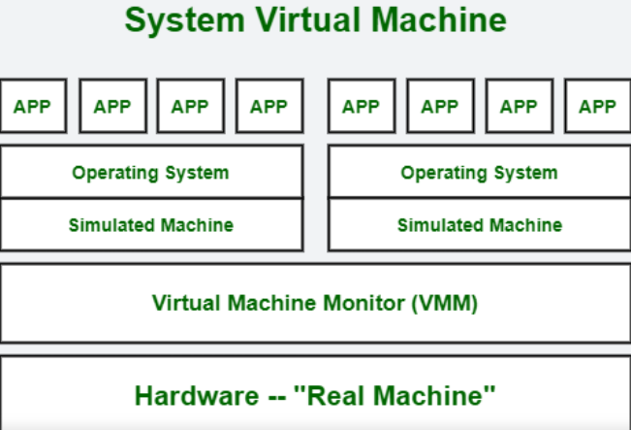
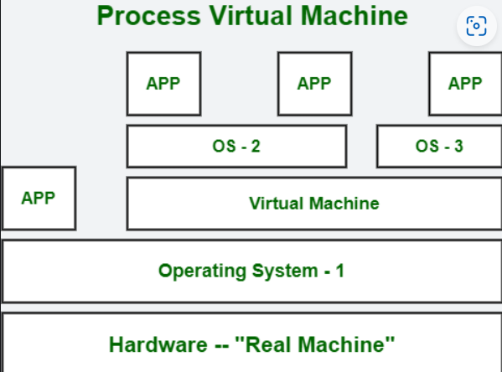
Architectures OF TYPES OF VIRTUAL MACHINES
Image(s) Source: Types of Virtual Machines - GeeksforGeeks

Slide 6
HOW DOES A VIRTUAL MACHINE WORK?
Virtualization provides with dedicated software based memory, CPU and storage.
The overall process is done by the hypervisor software.
Depending on the need, resources are moved from host towards guest by the hypervisor.
Hypervisor also schedules the operations in virtual machines in order to avoid conflicts that can arise while using the resources.

Slide 7
REFERENCES
Websites:
JavaTpoint - Virtual Machine - Javatpoint
GeeksForGeeks - Virtual Machine: Uses, Working, Examples – GeeksforGeeks
CrazyProgrammer - Advantages and Disadvantages of Virtual Machine (thecrazyprogrammer.com)
FreeCodeCamp - What is a Virtual Machine And How to Setup a VM (freecodecamp.org)

Slide 8
THANK YOU!

